Slide 1

Fostemsavir in a real-world setting: over one year of data from the PRESTIGIO Registry
Rebecka Papaioannu Borjesson¹, Golnaz Torkjazi², Nicolò Capra¹, Filippo Lagi³, Laura Comi⁴, Riccardo Lolatto¹, Elisa Garlassi⁵, Annalisa Saracino⁶, Cecilia Costa⁷, Maria Cristina Moioli⁸, Maurizio Zazzi⁹, Antonella Castagna^{1,2}
¹IRCCS San Raffaele Scientific Institute, Infectious Diseases Department, Milan, Italy, ²Vita-Salute San Raffaele University, Milan, Italy, ³Infectious and Tropical Diseases Unit, Careggi University Hospital, Florence, Italy, ⁴ASST Papa Giovanni XXIII, Infectious Diseases, Bergamo, Italy, ⁵Malattie Infettive Arcispedale S. Maria Nuova-IRCSS, Reggio Emilia, Italy, ⁶Clinic of Infectious Diseases, University of Bari, Bari, Italy, ⁷Infectious Diseases Unit, Department of Multidimensional Medicine, Santa Maria Annunziata Hospital, Bagno a Ripoli, Florence, Italy, ⁸Department of Infectious Diseases, ASST Grande Ospedale Metropolitano Niguarda, Milan, Italy, ⁹Department of Medical Biotechnology, University of Siena, Siena, Italy

Slide 2
Declaration of interest
I do not have an affiliation (financial or otherwise) with pharmaceutical,
medical device or communications organisation.

Slide 3
Background
In the BRIGHTE trial, the virologic response to fostemsavir was 79% (randomized cohort) and 59% (non-randomized cohort) at the observed analysis, 60% (randomized cohort) and 37% (non-randomized cohort) in the intention-to-treat population at week 96¹
Through week 96 and 240, BRIGHTE trial showed a maintenance in virologic response, sustained improvement in immunological response (increase in CD4+ T-cell count) and good tolerability to treatment with fostemsavir
1. M. Lataillade et al., Safety and efficacy of the HIV-1 attachment inhibitor prodrug fostemsavir in heavily treatment-experienced individuals: week 96 results of the phase 3 BRIGHTE study. Lancet HIV, 2020

Slide 4
Objective
To assess the virological outcomes of fostemsavir-containing regimens in people with 4-class drug-resistant HIV (4DR-PWH) in a real-life setting

Slide 5
Material and Methods
PRESTIGIO Registry: Italian registry which collects clinical and laboratory data on individuals with documented genotypic resistance to:
nucleoside reverse transcriptase inhibitors (NRTIs)
non-NRTIs (NNRTIs)
protease inhibitors (PIs)
integrase strand transfer inhibitors (INSTIs) or virological failure to an INSTI-based regimen in absence of mutations
Follow-up: from date of fostemsavir initiation (baseline) until treatment discontinuation for any cause, loss-to-follow-up, death or last visit

Slide 6
Definitions and statistical analysis
Virological suppression (VS): ≥1 viral load (VL) <50 copies/mL in individuals with a baseline VL ≥50 copies/mL
Virological failure (VF): ≥2 consecutive VLs ≥50 copies/mL or ≥1 VL ≥1000 copies/mL, or failure to achieve VS in viremic individuals at baseline
Kaplan-Meier curve and cumulative incidence function estimated probabilities of fostemsavir retention and VS, respectively. CD4+ and CD4+/CD8+ variation assessed using Wilcoxon signed-rank test. Data were reported as median (IQR) or frequency (%)

Slide 7
4DR-PWH characteristics
CHARACTERISTICS | HIVRNA ≥ 50 cp/mL at BL* n=40 | HIVRNA < 50 cp/mL at BL* n=12
Age at BL | 55.8 (47.9-60.1) | 60.5 (42.6-66.1)
Gender at BL (male) | 33 (82.5%) | 9 (75%)
Years of HIV at BL | 27.0 (22.6-33.2) | 33.7 (31.5-35.6)
Years of ART at BL | 25.2 (19.6-28.5) | 28.9 (26.4-30.2)
Nadir CD4+ at BL (cells/mm3) | 70 (7-152) | 173 (46-245)
HIVRNA at BL (copies/mL) | 1149.5 (122-60182) | < 20 (0.9-27.5)
CD4+ at BL (cells/mm3) | 275 (150-700) | 686.5 (212-948)
CD8+ at BL (cells/mm3) | 870 (520-1425) | 1154 (779-1563)
CD4+/CD8+ at BL | 0.32 (0.16-0.54) | 0.86 (0.47-1.1)
History of AIDS at BL | 17 (42.5%) | 4 (33.3%)
FTR duration (months) | 24.4 (12.1-45.3) | 10.7 (6.7-16.0)
*Data reported as median (IQR) or frequency (%)

Slide 8
High resistance to antiretrovirals at baseline (Stanford HIVdb score >60)

Slide 9
Drugs associated to FTR at baseline

Slide 10
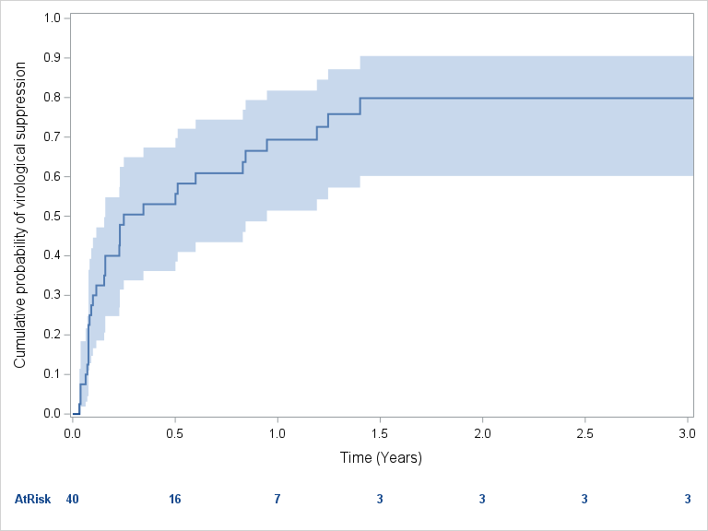
Virological success
Among viremic participants, 32/40 (80%) individuals achieved VS during a median of 2.32 (0.9-8.6) years
Estimated 2-years probability of VS was 80%

Slide 11
Virological failure
8/40 (20%) and 1/12 (8%) PWH experienced VF among viremic and non-viremic individuals, respectively
PWH ID | HIVRNA at BL (copies/mL) | CD4+ at BL (cells/mm3) | OBT at BL | HIVRNA at failure (copies/mL) | CD4+ at failure (cells/mm3) | FTR duration (years) | Rescue therapy
100-0007 | 598 | 610 | DRV,/r DTG | 134 | 440 | 0.77 | DRV/r, DTG
101-0005 | 99096 | 7 | FTC, TDF, DRV/r, DTG | 288161 | 3 | 1.89 | 3TC, DRV/r, DTG
102-0016 | 88 | 1390 | FTC, TAF, DOR, DTG, LEN | 120 | 1572 | 1.28 | FTC, TAF, DTG, LEN, DRV/r
104-0018 | 532210 | 2 | TDF, DRV/r, DTG | 5711 | 11 | 0.23 | -
104-0031 | 294300 | 21 | ATV/c, MVC | 125909 | 15 | 0.30 | FTC, TAF, ATV/c, DTG
108-0022 | 98032 | 64 | FTC, TAF, DRV/c, BIC, LEN | 80571 | 96 | 0.19 | FTC, TAF, DRV/c, BIC, LEN
109-0007 | 451 | 163 | FTC, TAF, DOR, DRV/c | 103 | 120 | 1.00 | FTC, TAF, DOR, DRV/c
110-0012 | 315 | 117 | 3TC, DOR, DTG | 1800 | 98 | 0.77 | TDF, ETV, LEN
111-0001 | 20 | 640 | DOR, LEN | 73 | 1120 | 0.16 | DOR, LEN

Slide 12
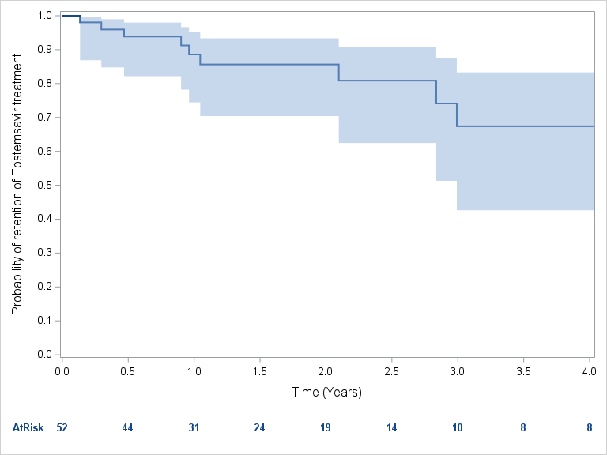
Overall FTR maintenance
Among viremic and non-viremic 4DR-PWH, after a median follow-up of 15.6 months, 11/52 (21%) 4DR-PWH discontinued fostemsavir, with a 4-year probability of FTR maintenance of 67.4%
Overall, an increase in CD4+ T-cell count [34 cells/mm3 (-118-208), p=0.056] and in CD4+/CD8+ [0.03 (-0.01-0.15), p=0.0034] by the end of follow-up was documented

Slide 13
Conclusions
In this real-life cohort of 4DR-PWH, fostemsavir-including regimens were effective in both achieving and maintaining viral suppression during 2 years of follow-up
Studies with longer follow-up and on the combination of fostemsavir with new antiretroviral agents with novel mechanisms of action are currently ongoing

Slide 14

Acknowledgements
STEERING COMMITTEE: Antonella Castagna (Coordinatore), Vincenzo Spagnuolo (Coordinatore operativo), Daniele Armenia, Stefano Bonora, Leonardo Calza, Anna Maria Cattelan, Giovanni Cenderello, Adriana Cervo, Laura Comi, Antonio Di Biagio, Emanuele Focà, Roberta Gagliardini, Andrea Giacomelli, Filippo Lagi, Giulia Marchetti, Stefano Rusconi, Francesco Saladini, Maria Santoro, Maurizio Zazzi
VIROLOGY TEAM AND BIOLOGICAL BANK: Andrea Galli, Daniele Armenia, Francesco Saladini, Maria Santoro, Maurizio Zazzi, BioRep SRL
STUDY COORDINATORS: Elisabetta Carini, Sabrina Bagaglio, Girolamo Piromalli
STATISTICAL AND MONITORING TEAM: Lolatto, Nicolò Capra
ENROLLING CENTERS: ANCONA: Marcello Riccardo Tavio, Alessandra Mataloni Paggi; AOSTA: Silvia Magnani, Manuela Colafigli AVIANO: Ornella Schioppa, Stefania Zanussi, Valentina Da Ros, Silvia Rossetto; BARI: Annalisa Saracino, Flavia Balena; BERGAMO: Laura Comi, Daniela Valenti; BOLOGNA: Pierluigi Viale, Leonardo Calza, Maddalena Giglia, Claudio Rigamonti, Silvia Cretella; BRESCIA: Francesco Castelli, Emanuele Focà, Davide Minisci; BUSTO ARSIZIO: Barbara Menzaghi, Maddalena Farinazzo, Chiara Abeli; CATANIA: Bruno Cacopardo, Maurizio Celesia, Michele Salvatore Paternò Raddusa, Carmen Giarratana; CATANZARO: Paolo Fusco, Vincenzo Olivadese, Simona Mongiardi; CREMONA: Angelo Pan, Chiara Fornabaio, Paola Brambilla; FIRENZE: Alessandro Bartoloni, Filippo Lagi, Paola Corsi, Sasha Trevisan, Giuseppe Gasparro, Cecilia Costa, Alessio Bellucci, Elisa Mariabelli; FOGGIA: Teresa Santantonio, Sergio Lo Caputo, Sergio Ferrara, Arianna Narducci; GENOVA: Emanuele Pontali, Marcello Feasi, Antonio Sarà, Matteo Bassetti, Antonio Di Biagio, Sabrina Blanchi; LECCO: Stefania Piconi, Martina Bottanelli, Silvia Pontiggia, Giada Valsecchi ; LEGNANO: Stefano Rusconi, Cinzia Roberta Bassoli, Francesco Bassani, Liana Bevilacqua; MILANO: Antonella Castagna, Vincenzo Spagnuolo, Riccardo Lolatto, Nicolò Capra, Rebecka Papaioannu, Tommaso Clemente, Elisabetta Carini, Girolamo Piromalli, Sabrina Bagaglio, Andrea Galli, Camilla Muccini, Golnaz Torkjazi, Spinello Antinori, Andrea Giacomelli, Tiziana Formenti, Giacomo Pozza, Giulia Marchetti, Lidia Gazzola, Fabiana Trionfo Fineo, Massimo Puoti, Cristina Moioli, Federico D’Amico, Simoncini Elena, Sassi Serena; MODENA: Cristina Mussini, Adriana Cervo, Giulia Nardini; NAPOLI: Elio Manzillo, Antonella Gallicchio; PADOVA: Anna Maria Cattelan; PALERMO: Antonio Cascio, Marcello Trizzino; PARMA: Elisa Fronti, Diletta Laccabue, Federica Carli; PAVIA: Roberto Gulminetti, Layla Pagnucco, Mattia Demitri, Alessandra Ferrari; PERUGIA: Daniela Francisci, Giuseppe De Socio, Elisabetta Schiaroli; REGGIO EMILIA: Elisa Garlassi, Romina Corsini; ROMA: Roberta Gagliardini, Marisa Fusto, Loredana Sarmati, Vincenzo Malagnino, Tiziana Mulas, Mirko Compagno, Carlo Torti, Simona Di Giambenedetto, Silvia Lamonica, Pierluigi Salvo; SANREMO: Giovanni Cenderello, Rachele Pincino, Davide Laurenda; SASSARI: Giordano Madeddu, Andrea De Vito; SIENA: Mario Tumbarello, Massimiliano Fabbiani, Francesca Panza, Ilaria Rancan; TORINO: Giovanni Di Perri, Stefano Bonora, Micol Ferrara, Andrea Calcagno, Silvia Fantino, Giancarlo Orofino, Guido Calleri, Marta Guastavigna; VERONA: Stefano Nardi, Marta Fiscon;
SUPPORTED BY: ViiV Healthcare, Gilead Sciences, MSD, Janssen-Cilag

Slide 15
Thank you

